Slide 2
Canada
Chapter Three
Learning Goals
To understand the geographical position， history， climate，economy， as well as the main pillars of Economy in Canada.
To know more about vocational education in Canada.

Slide 3
Canada
Chapter Three
Section A
Exploring the World
Section B
Broadening My Horizon
Section C
Reading for Pleasure

Slide 4
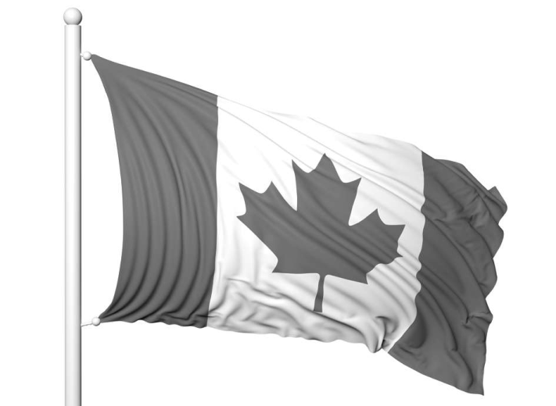
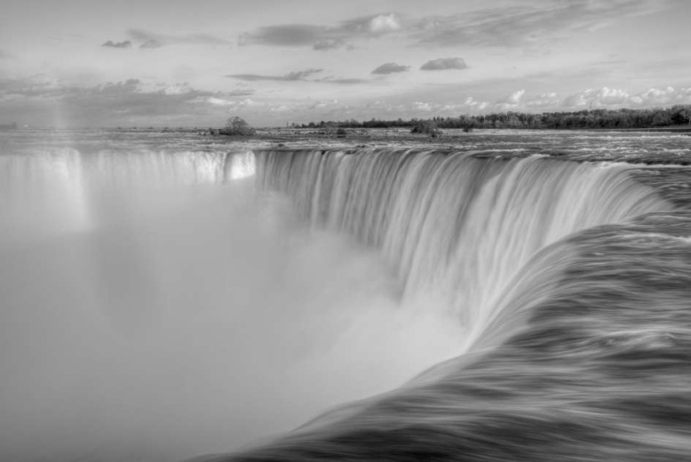
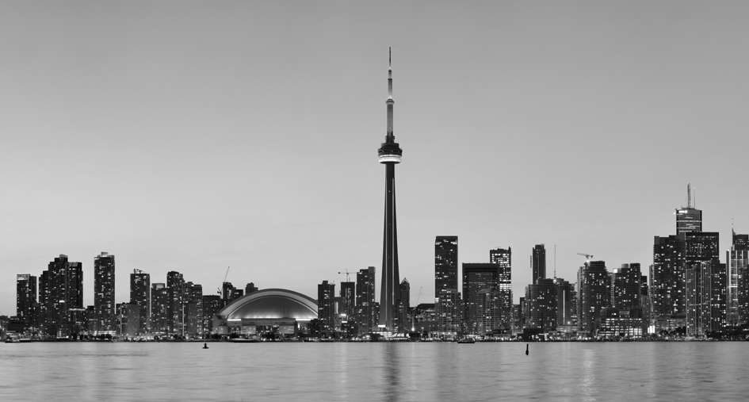
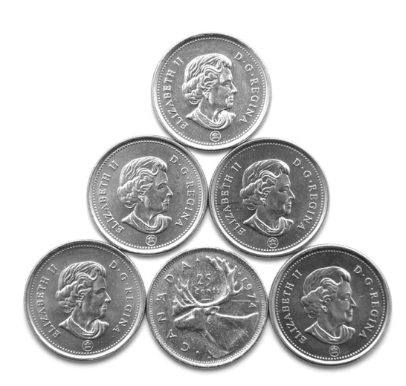
Exploring the World
Section A
Leading In

Slide 5
Exploring the World
Section A
Text A A Brief Introduction to Canada
Note
Geography and Climate
Canada^{[1]} occupies a major northern portion of North America^{[2]} , sharing land borders with the contiguous United States to the south and the U.S. state of Alaska to the northwest, stretching from the Atlantic Ocean in the east to the Pacific Ocean in the west; to the north lies the Arctic Ocean. By total area (including its waters), Canada is the second largest country in the world after Russia and largest on the continent.
In northwestern Canada, the Mackenzie River flows from the Great Slave Lake to the Arctic Ocean. A tributary of the Mackenzie is the South Nahanni River, which is home to Virginia Falls, a waterfall about twice as high as Niagara Falls^{[3]} .
To the north of this region is the broad Canadian Shield, an area of rock scoured clean by the last ice age, thinly soiled, rich in minerals, and dotted with lakes and rivers. Canada by far has more lakes than any other country and has much of the world’ s fresh water.

Slide 6
Exploring the World
Section A
Text A A Brief Introduction to Canada
Back
[1] 加拿大有 60%的领土位于北纬 60 度以北， 全国属大陆性气候， 冬季寒冷而漫长。年降水量在300mm左右。加拿大的农业高度发达， 生产规模大， 技术含量高， 粮食产量居世界前列。主要农作物有麦子、 亚麻、玉米、 马铃薯等。 加拿大国土面积998万多平方公里， 居世界第二位， 人口3100多万，其中华人约109万。英语和法语同为加拿大官方语言。首都为渥太华。
[2] 加拿大位于北美洲北部， 东临大西洋， 西濒太平洋， 南接美国本土， 北靠北冰洋， 西北部邻美国阿拉斯加州。枫树为加拿大的国树， 枫叶是加拿大民族的象征， 故加拿大享有 “枫叶之国” 的美誉。
[3] 尼亚加拉瀑布 (Niagara Falls) 是尼亚加拉河跌入河谷断层的产物。尼亚加拉河经过一道石灰岩断崖， 从海拔174米骤然陡落至海拔75米， 水势澎湃， 气势有如雷霆万钧。瀑布以河床绝壁上的山羊岛 (Coat Is-land) 为界， 分加拿大瀑布与美国瀑布， 其中尤以加拿大瀑布更为雄伟壮观。

Slide 7
Exploring the World
Section A
Text A A Brief Introduction to Canada
Political System
A federation comprising ten provinces and three territories, Canada is a parliamentary democracy and a constitutional monarchy, with Queen Elizabeth II as its head of state. It is a bilingual and multicultural country, with both English and French as official languages both at the federal level and in the province of New Brunswick.
Technologically advanced and industrialized, Canada maintains a diversified economy that is heavily reliant upon its abundant natural resources and upon trade — particularly with the United States, with which Canada has had a long and complex relationship.
The provinces are responsible for most of Canada’s social programs (such as health care, education, and welfare) and together collect more revenue than the federal government, an almost unique structure among federations in the world. Using its spending powers, the federal government can initiate national policies in provincial areas, such as the Canada Health Act; the provinces can opt out of these, but rarely do so in practice. Equalization payments are made by the federal government to ensure that reasonably uniform standards of services and taxation are kept between the richer and poorer provinces.

Slide 8
Exploring the World
Section A
Text A A Brief Introduction to Canada
Note
Population
The land occupied by Canada was inhabited by various groups of aboriginal people. Beginning in the late 15th century, British and French expeditors explored and later settled along the Atlantic coast. France ceded nearly all of its colonies in North Canada in 1763 after the Seven Years’ War. In 1867, with the union of three British North Canada colonies through Confederation, Canada was formed as a federal dominion of four provinces. This began an accretion of additional provinces and territories and a process of increasing autonomy from the United Kingdom, highlighted by the Statute of Westminster in 1931 and culminating in the Canada Act in 1982, which severed the vestiges of legal dependence on the British parliament.
Canada’ s National Sports
Canada’s official national sports are hockey in winter and lacrosse in summer. Hockey is a national pastime and the most popular spectator sport in the country. It is also the most popular sport Canadians play, with 1.65 million active participants in 2004. Canada’s six largest metropolitan areas Toronto^{[4]} , Montreal, Vancouver, Ottawa, Calgary, and Edmonton have franchises in the National Hockey League (NHL), and there are more Canadian players in the league than from all the other countries combined. After hockey, other popular spectator sports include curling and football; the latter is played professionally in the Canadian Football League. Golf, baseball, skiing, soccer, volleyball, and basketball are widely played at youth and amateur levels, but professional leagues and franchises are not as widespread.

Slide 9
Exploring the World
Section A
Text A A Brief Introduction to Canada
Back
[4] 多伦多位于安大略湖西北岸。多伦多(Toronto)这个词在原住民印第安人的语言中是 “人群聚集之处” 的意思。多伦多也是华人聚居的城市之一。

Slide 10
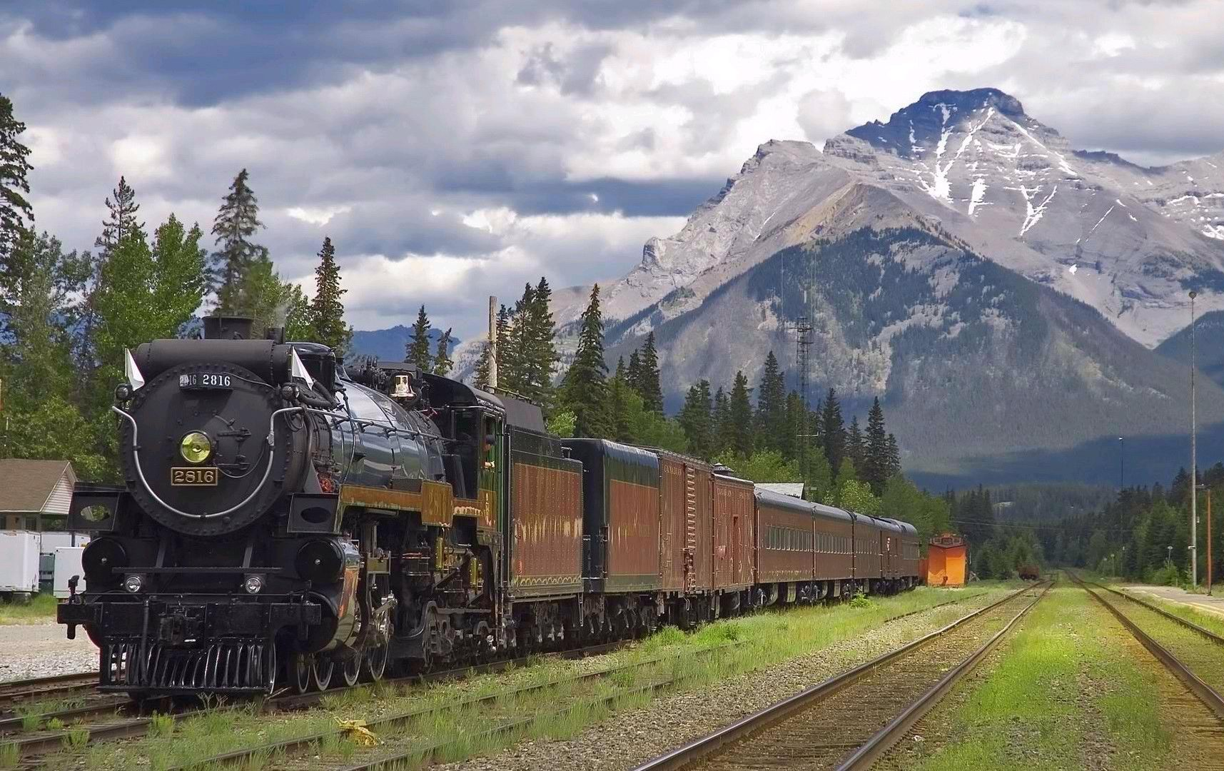
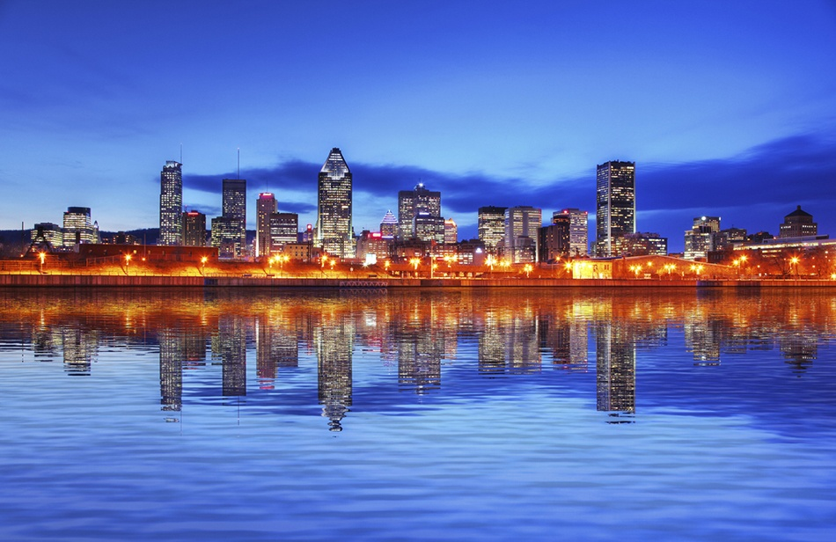
Exploring the World
Section A
Text A A Brief Introduction to Canada
Canada hosted several high-profile international sporting events, including the 1976 Summer Olympics, the 1988 Winter Olympics, 2010 Winter Olympics, and the 2007 FIFA U-20 World Cup.

Slide 11
Exploring the World
Section A
Vocabulary Power
major a. 较大的； 较多的
portion n. 部分
v. 把……分成多份
continent n. 大陆， 陆地； 欧洲大陆
pastime n. 消遣； 娱乐
spectator n. 观众之一； 旁观者； 目击者
league n. 同盟， 联盟， 盟约； 俱乐部联合会
combined a. 联合的； 相加的
professionally ad. 专业地； 内行地

Slide 12
Exploring the World
Section A
Lesson Review
Task 1 Search the information about Canada, and fill in the following form.
Capital
Official Languages
Recognized Regional Languages
Government
Total Area
Population
Climate
National Sports
Time Zone
Famous Universities

Slide 13
Exploring the World
Section A
Lesson Review
Task 2 Gap-filling
1. Canada is the ________ largest country in the world — after Russia — and largest on the continent.
2. In northwestern Canada, the Mackenzie River ________ from the Great Slave Lake to the Arctic Ocean.
3. Canada has more lakes than any other country and has much of the world’ s ________ water by far.
4. Canada is a parliamentary democracy and ________ monarchy, with Queen Elizabeth II as its head of state.
5. The provinces can opt out of these, but ________ do so in practice.

Slide 14
Exploring the World
Section A
Lesson Review
Task 2 Gap-filling
6. The land occupied by Canada was inhabited by various ________ aboriginal people.
7. France ceded nearly ________ its colonies in North Canada in 1763 after the Seven Years’ War.
8. Canada is a ________ composed of ten provinces and three territories.
9. Canada was the ________ country for the 2010 Winter Olympics in Vancouver and Whistler, British Columbia.
10. Hockey is the most ________ sport Canadians play, with 1.65 million active participants in 2004.

Slide 15
Exploring the World
Section A
Lesson Review
Task 3 Please retell anything about Canada, without referring to the text. Take turns to tell others any information mentioned in it, or supplement it with something else that you knew before.

Slide 16
Exploring the World
Section A
Text B Economy of Canada
Note
Canada is one of the world’ s wealthiest nations, with a high per capita income, and is a member of the Organisation for Economic Co-operation and Development^{[1]} and the G8^{[2]} . It is one of the world’s top ten trading nations. Canada is a mixed market, ranking lower than the U.S. but higher than most Western European nations on the Heritage Foundation’s index of economic freedom. Since the early 1990s, the Canadian economy has been growing rapidly, with low unemployment and large government surpluses on the federal level. Today, Canada resembles the U.S. in its market- oriented economic system, pattern of production, and high living standards. As of February 2009, Canada’s national unemployment rate was 7.77% . Provincial unemployment rates vary from a low of 3.6% in Alberta to a high of 14.6% in Newfoundland and Labrador. According to the Forbes Global 2000 list of the world’s largest companies in 2008, Canada had 69 companies in the list, ranking 5th next to France. As of 2008, Canada’ s total government debt burden was the lowest in the G8. According to these projections, Canada’ s debt burden will have fallen over 50 percentage points from the peak in 1995, when it was the second highest in the G8.

Slide 17
Exploring the World
Section A
Text B Economy of Canada
Back
[1] 经济合作与发展组织 (OECD) ， 是由30个市场经济国家组成的政府间国际经济组织， 经合组织的历史可以追溯到二战后重建欧洲经济的马歇尔计划， 在本质上， 成员国仅限于实行市场经济和多元民主国家。
[2] 八国集团首脑会议 (G8 Summit)由西方七国首脑会议演变而来， 八国是指美国、 英国、 法国、 德国、 意大利、 加拿大、 日本和俄罗斯。

Slide 18
Exploring the World
Section A
Text B Economy of Canada
Canada is one of the world’ s most important suppliers of agricultural products. In the past century, the growth of the manufacturing, mining, and service sectors has transformed the nation from a largely rural economy into one primarily industrial and urban. As with other first world nations, the Canadian economy is dominated by the service industry, which employs about three quarters of Canadians. However, Canada is unusual among developed countries in the importance of the primary sector, with the logging and oil industries being two of Canada’ s most important.
Canada is one of the few developed nations that are net exporters of energy. Atlantic Canada has vast offshore deposits of natural gas and large oil and gas resources are central in Alberta. The vast Athabasca Oil Sands give Canada the world’ s second-largest oil reserves, behind Saudi Arabia. In Quebec, British Columbia, Newfoundland & Labrador, one of the most important suppliers of wheat, canola, and other grains. Canada is the world’ s largest producer of zinc and uranium and a world leader in many other natural resources such as gold, nickel, aluminium , and lead ; many towns in the northern part of the country, where agriculture is difficult, because of a nearby mine or source of timber. Canada also has a sizable manufacturing sector central in southern Ontario and Quebec, with automobiles and aeronautics representing particularly important industries.

Slide 19
Exploring the World
Section A
Vocabulary Power
per capita income 人均收入
heritage n. 遗产， 世袭财产， 继承物； 遗留物； 传统
foundation n. 基金会， 基金， 维持基金
rapidly ad. 很快地， 立即， 迅速地
unemployment n. 失业； 失业状态， 失业人数
system n. 体系； 系统， 制度， 体制

Slide 20
Exploring the World
Section A
Lesson Review
Task Gap-filling
1. Canada is one of the ___________ top ten trading nations.
2. Canada resembles the U.S. in its market-oriented economic system, ___________ of production, and high living standards.
3. Canadian ___________ has been growing rapidly.
4. Canada is ___________ the few developed nations that are net exporters of energy.
5. Atlantic Canada ___________ vast offshore deposits of natural gas and large oil and gas resources are central in Alberta.

Slide 21
Exploring the World
Section A
Lesson Review
Task Gap-filling
6. Canada’ s debt burden ___________ over 50 percentage points from the peak in 1995.
7. Canada’ s ___________ unemployment rate was 7.77%.
8. The Canadian economy is dominated ___________ service industry, which employs about three quarters of Canadians.
9. One of the important ___________ of wheat, canola, and other grains.
10. Where agriculture is difficult, ___________ of a nearby mine or source of timber.

Slide 22
Broadening My Horizon
Section B
Text A Education in Canada
Education in Canada is provided, funded and overseen by federal, provincial, and local governments. Education is within provincial jurisdiction and the curriculum is overseen by the province. Education in Canada is generally divided into Elementary (Primary School, Public School), followed by Secondary (High School) and Post Secondary (University, College). Within the provinces under the ministry of education, there are district school boards administering the educational programs. Education is compulsory up to the age of 16 in every province in Canada, except for Ontario and New Brunswick, where the compulsory age is 18. In some provinces early leaving exemptions can be granted under certain circumstances at 14. Canada generally has 190 school days in the year, officially starting from September (after Labour Day) to the end of June (usually the last Friday of the month).
Most Canadian education systems continue up to Grade 12 (age 17 to 18). In Quebec, the typical high school term ends after Secondary V, the same as to Grade 11 (age 16 to 17); following this, students who wish to pursue their studies to the university level have to attend CEGEP.

Slide 23
Broadening My Horizon
Section B
Text A Education in Canada
Pre-university
Primary education and secondary education combined are sometimes referred to as K-12 (Kindergarten through Grade 12). It should be noted that this structure can vary from school to school, and from province to province. In contrast, Ontario is the only province which provides two levels of Kindergarten (Junior and Senior).
In Canada, secondary schooling, known as high school or collegiate institute or “école secondaire” or secondary school, differs depending on the province in which one resides. Additionally, grade structure may vary within a province and even within a school division. Education is compulsory up to the age of 16 in every province in Canada, except for Ontario and New Brunswick (where the compulsory age is 18).

Slide 24
Broadening My Horizon
Section B
Text A Education in Canada
Post-secondary Education
Post- secondary education in Canada is also the responsibility of the individual provinces and territories. Those governments provide the majority of funding to their public post-secondary institutions, with the remainder of funding coming from tuition fees, the federal government, and research grants. Compared with other countries in the past, Canada has had the highest tertiary school enrollment as a percentage of their graduating population.
Nearly all post-secondary institutions in Canada have the authority to grant academic credentials (i.e., diplomas or degrees). Generally speaking, universities grant degrees (e.g., Bachelor’ s, Master’ s or Doctor’ s degree), while colleges, which typically offer vocationally-oriented programs, grant diplomas and certificates. The main variation between the provinces, with respect to universities, is the amount of funding they receive. Universities in Quebec receive the most funding and have the lowest tuitions. Universities in Atlantic Canada generally receive the least funding and some, like Acadia University, are almost wholly reliant on private funding.

Slide 25
Broadening My Horizon
Section B
Text A Education in Canada
Private Schools
About 8% of students are in private schools. A minority of these are elite private schools. These schools are attended by only a small fraction of students, but do have a great deal of prestige and prominence. It is not unusual for the wealthy and prominent in Canada to send their children to public schools, especially in the lower grades. A far larger portion of private schools are religious based institutions. Private schools are also used to study outside the country. For example CCI has an Ontario curriculum, but the students study in Italy.
Private Universities
At present, all private universities in Canada maintain a religious history or foundation. British Columbia’s Quest University will become the first privately funded liberal arts university without a denominational affiliation (although it is not the first private liberal arts university). Many provinces, including Ontario and Alberta, have passed legislation allowing private degree- granting institutions (not necessarily universities) to operate there.

Slide 26
Broadening My Horizon
Section B
Text A Education in Canada
Many Canadians remain polarized on the issue of permitting private universities into the Canadian market. On the one hand, Canada’ s top universities find it difficult to compete with the private American powerhouses because of funding, but on the other hand, the fact that the price of private universities tends to exclude those who cannot pay that much for their education could prevent a significant portion of Canada’ s population from being able to attend these schools.
Religious Schools
Each province deals differently with private religious schools. In Ontario the Catholic system continues to be fully publicly funded, but other faiths receive no such funding. Ontario has several private Jewish, Muslim, and Christian schools, but all are funded through tuition fees. Since the Catholic school system is entrenched in the constitution, the Supreme Court has ruled that this system is constitutional. These schools have to follow the provincial curriculum and meet all standards, but are given considerable freedom in other areas. In all the other provinces, private religious schools receive some funding, but not as much as the public system.

Slide 27
Broadening My Horizon
Section B
Vocabulary Power
jurisdiction n. 司法权， 审判权
curriculum n. 课程
exemption n. 免税， 免除
collegiate a. 大学的， 学院的
prestige n. 声望， 威望
prominence n. 显著， 卓越

Slide 28
Broadening My Horizon
Section B
My Project
Task Search the following information and present your findings to your classmates.
1
degree granting powers of pre-university in Canada
2
private schools in different parts of Canada
3
the role of religion in Canadian education

Slide 29
Broadening My Horizon
Section B
Text B History
Note
First Nation and Inuit^{[1]} traditions maintain that indigenous people have resided on their lands since the beginning of time, while archaeological studies support a human presence in the northern Yukon from 26,500 years ago, and in southern Ontario from 9,500 years ago. Europeans first arrived when the Vikings settled briefly at L’ Anse aux Meadows around AD 1000; following the failure of that colony, there was no further attempt at North American exploration until 1497, when John Cabot explored Canada’ s Atlantic coast for England, followed by Jacques Cartier in 1534 for France.
French explorers arrived in 1603 and established the first permanent European settlements at Port Royal in 1605 and Quebec City in 1608. These would become, respectively, the capitals of Acadia and Canada. Among French colonists of New France, Canadians extensively settled the Saint Lawrence River valley, Acadians settled the present-day Maritimes, while French fur traders and Catholic missionaries explored the Great Lakes, Hudson Bay, and the Mississippi watershed to Louisiana. The French and Iroquois Wars broke out over control of the fur trade.

Slide 30
Broadening My Horizon
Section B
Text B History
Back
[1] 加拿大北部居住着因纽特人或叫爱斯基摩人。因纽特人不喜欢人们称他们为“爱斯基摩人” (Eskimo) ， 因其意为 “吃生肉的人” ， 而“因纽特” 是他们的自称， 意思是 “人类” 。他们主要靠猎捕海生哺乳动物和陆地哺乳动物为食， 他们的食谱中还是以肉食为主 。

Slide 31
Broadening My Horizon
Section B
Text B History
Note
The English established fishing outposts in Newfoundland around 1610 and colonized the Thirteen Colonies to the south. A series of four Intercolonial Wars erupted between 1689 and 1763. Mainland Nova Scotia came under British rule with the Treaty of Utrecht (1713); the Treaty of Paris (1763) ceded Canada and
most of New France to Britain following the Seven Years’ War^{[2]} .
The Royal Proclamation (1763) carved the Province of Quebec out of New France and annexed Cape Breton Island to Nova Scotia. It also restricted the language and religious rights of French Canadians. In 1769, St. John’ s Island (now Prince Edward Island) became a separate colony. To avert conflict in Quebec, the Quebec Act of 1774 expanded Quebec’ s territory to the Great Lakes and Ohio Valley and re-established the French language, Catholic faith, and French civil law in Quebec; it angered many residents of the Thirteen Colonies, helping to fuel the American Revolution. The Treaty of Paris (1783) recognized American independence and ceded territories south of the Great Lakes to the United States. Approximately 50,000 United Empire Loyalists fled the United States to Canada. New Brunswick was split from Nova Scotia as part of a reorganization of Loyalist settlements in the Maritimes. To accommodate English-speaking Loyalists in Quebec, the Constitutional Act of 1791 divided the province into French-speaking Lower Canada and English-speaking Upper Canada, granting each their own elected Legislative Assembly.

Slide 32
Broadening My Horizon
Section B
Text B History
Back
[2] 在1763年结束的七年战争后， 英法签订了 《巴黎条约》 ， 法国放弃了他们在北美殖民地的主权。

Slide 33
Broadening My Horizon
Section B
Text B History
Canada (Upper and Lower) was the main front in the War of 1812 between the United States and the British Empire. The defense of Canada contributed to a sense of unity among British North Americans. Large-scale immigration to Canada began in 1815 from Britain and Ireland. The timber industry surpassed the fur trade in importance in the early nineteenth century. The desire for responsible government resulted in the aborted Rebellions of 1837. The Durham Report subsequently recommended responsible government and the assimilation of French Canadians into British culture. The Act of Union (1840) merged Canada into a United Province of Canada. French and English Canadians worked together in the Assembly to reinstate French rights.
Responsible government was established for all British North American provinces by 1849.
The signing of the Oregon Treaty by Britain and the United States in 1846 ended the Oregon boundary dispute, extending the border westward along the 49th parallel and paving the way for British colonies on Vancouver Island (1849) and in British Columbia (1858). Canada launched a series of western exploratory expeditions to claim Rupert’s Land and the Arctic region. The Canadian population grew rapidly because of high birth rates; British immigration was offset by emigration to the United States, especially by French Canadians’ moving to New England.

Slide 34
Broadening My Horizon
Section B
Text B History
An animated map, exhibiting the growth and change of Canada’s provinces and territories since Confederation.
Following several constitutional conferences, the Constitution Act (1867) brought about Confederation creating “one Dominion under the name of Canada” on July 1, 1867, with four provinces: Ontario, Quebec, Nova Scotia, and New Brunswick. Canada assumed control of Rupert’s Land and the North- western Territory to form the Northwest Territories, where the Métis’ grievances ignited the Red River Rebellion and the creation of the province of Manitoba in July 1870. British Columbia and Vancouver Island (which had united in 1866) and the colony of Prince Edward Island joined the Confederation in 1871 and 1873, respectively.

Slide 35
Broadening My Horizon
Section B
Vocabulary Power
indigenous a. 土产的； 土著的
permanent a. 永久的， 永恒的； 常在的
respectively ad. 分别地， 各自
colonist n. 殖民地开拓者， 拓殖者； 殖民地居民
missionary n. 传教士
erupt v. 喷出； 爆发； 发疹； 长牙
carve v. 刻， 雕刻； 切开； 切(肉菜)； 开创(事业等)； 开拓
resident n. 居民， 定居者； 侨民
legislative a. 立法的； 有立法权的
subsequently ad. 其后， 随后， 接着
dispute n. 争论； 争执

Slide 36
Broadening My Horizon
Section B
Lesson Review
Task Gap-filling
1. French explorers arrived in 1603 and established the first ________ European settlements at Port Royal in 1605 and Quebec City in 1608.
2. John Cabot explored Canada’ s Atlantic coast for England in 1497, ________ by Jacques Cartier in 1534 for France.
3. These would become, ________ , the capitals of Acadia and Canada.
4. The desire for responsible government resulted ________ aborted Rebellions of 1837.
5. It ________ restricted the language and religious rights of French Canadians.

Slide 37
Broadening My Horizon
Section B
Lesson Review
Task Gap-filling
6. Responsible ________ was established for all British North American provinces by 1849.
7. The Canadian grew rapidly because of high birth ________ .
8. A series ________ four Intercolonial Wars erupted between 1689 and 1763.
9. The French and Iroquois Wars broke ________ over control of the fur trade.
10. British Columbia and Vancouver Island (which had united in 1866) and the colony of Prince Edward Island ________ the Confederation in 1871 and 1873, respectively.

Slide 38
Reading for Pleasure
Section C
Text A The Name of Canada
The name Canada comes from a Saint Lawrence Iroquoian word, “kanata” , meaning “village” or “settlement” . In 1535, indigenous inhabitants of the present-day Quebec City region used the word to direct French explorer Jacques Cartier towards the village of Stadacona. Cartier later used the word to refer not only to that particular village, but also the entire area subject to Donnacona. By 1545, European books and maps had begun referring to this region as Canada.
From the early 17th century onwards, that part of New France that lay along the Saint Lawrence River and the northern shores of the Great Lakes was named Canada, an area that was later split into two British colonies, Upper Canada and Lower Canada, until their re-unification as the Province of Canada in 1841. Upon Confederation in 1867, the name Canada was adopted as the legal name for the new country, and Dominion was conferred as the country’ s title; combined, the term Dominion of Canada was in common usage until the 1950s. Thereafter, as Canada asserted its political autonomy from Britain, the federal government increasingly used simply Canada on state documents and treaties, a change that was reflected in the renaming of the national holiday from Dominion Day to Canada Day in 1982.

Slide 39
Reading for Pleasure
Section C
Vocabulary Power
shore n. 海滨
legal a. 法律上的， 有关法律的， 合法的， 正当的
confer v. 授予， 给予
assert vt. 断言， 声称， 坚持； 主张拥有， 显示； 确立
autonomy n. 自治， 自治权

Slide 40
Reading for Pleasure
Section C
Lesson Review
Task 1 Gap-filling
1. The name Canada comes from a Saint Lawrence Iroquoian word, “kanata” , ________ “village” or “__________” .
2. Cartier later used the word to refer not only to that ________ village, but also the entire area subject to Donnacona.
3. By 1545, European books and maps had begun ________ to this region as Canada.
4. The name Canada was ________ as the legal name for the new country.
5. The change was reflected in the ________ of the national holiday from Dominion Day to Canada Day in 1982.

Slide 41
Reading for Pleasure
Section C
Lesson Review
Task 2 Search more information about the history, economy, and culture of Canada.

Slide 42
Reading for Pleasure
Section C
Text B Canadian Border Crossing Laws for Dogs
When going on vacation to Canada, many people like to take their household pets with them. This is especially true when it comes to the family dog. However, it is important to remember that animals are not allowed to freely cross the border between the United States and Canada without fulfilling certain requirements.
Disease
Before a dog can be transported across the border, they must be free of disease. Not all dogs will necessarily be chosen for examination. However, if a border patrol agent suspects that a dog has certain signs of disease, he will hold the dog until it can be determined that the dog is not a health risk. This is largely because some dog diseases can be transmitted to humans. You will want to get a letter from your veterinarian stating that your dog is free of all diseases before trying to bring it to cross the border with you.

Slide 43
Reading for Pleasure
Section C
Text B Canadian Border Crossing Laws for Dogs
Vaccinations
It is important that you gather together all your dog’s vaccination records before leaving for Canada. You will want to take a copy of all records with you in case you are asked for them by a border patrol agent. No dogs are allowed to cross the border without certification that the animal has had its rabies shots within the last 12 months. A dog must also wait at least 30 days after its vaccination before being able to cross the border. Before crossing the Canadian border, your dog must look physically healthy. If the border patrol agent sees any signs of sickness in your animal, he or she may disallow the pet from crossing with you across the border. This is regardless of whether you have certifications of vaccinations or a note from your veterinarian. Puppies under the age of 3 months are not required to have a rabies vaccination. This is because they are too young to fend off the possible side effects from the vaccine.

Slide 44
Reading for Pleasure
Section C
Vocabulary Power
household a. 家庭的， 家用的
border n. 边境， 国界
transport v. 运送； 流放
patrol n. 巡逻； 巡查
transmit v. 传播， 传染
veterinarian n. 兽医
vaccination n. 种痘； 接种
rabies n. 狂犬病
physically ad. 身体上， 体格上
disallow v. 不准， 不接受

Slide 45
Reading for Pleasure
Section C
Lesson Review
Task Have you got any idea about requirements for pets when crossing the border? Why not conduct a survey of it with your group members?

